Slide 1
AIM
Software
guidebook
documenting software architecture

Slide 2
Working software
“ ”
over
comprehensive
documentation
Manifesto for Agile Software Development

Slide 3
The code doesn’t tell the whole story

Slide 4
Software Architecture Document
Useful information spread across hundreds of pages; rarely read or updated

Slide 5




Travel Guidebook
(maps, points of interest, sights, itineraries, history, culture, practical information, etc)

Slide 6
Software Guidebook
(maps, points of interest, sights, itineraries, history, culture, practical information, etc)

Slide 7

https://leanpub.com/documenting-software-architecture/c/free

Slide 8
The scope is a single
software system

Slide 9
Describe what you
can’t get from the code

Slide 10
Documentation should be constantly evolving

Slide 11
Functional Overview
An overview of the software system; perhaps including wireframes, UI mockups, screenshots, workflow diagrams, business process diagrams, etc.
Quality Attributes
A list of the quality attributes (non-functional requirements;
e.g. performance, scalability, security, etc).
Constraints
A list of the environmental constraints (e.g. timescales, budget, technology,
team size/skills, etc).
Principles
A list of the development and architecture principles (e.g. coding conventions, separation of concerns, patterns, etc).
Context
A system context diagram, plus some narrative text to “set the scene”.
Software Architecture
A description of the software architecture, including static structure (e.g. containers and components) and dynamic/ runtime behaviour.
Code
A description of important or complicated component implementation details, patterns, frameworks, etc.
Data
Data models, entity relationship diagrams, security, data volumes, archiving strategies, backup strategies, etc.
This is a starting point; add and remove sections as necessary.
Infrastructure Architecture
A description of the infrastructure available
to run the software system.
Development Environment
A description of how a new developer gets started.
Operation and Support
An overview of how the software system is operated, supported, monitored, etc.
Decision Log
A log of the major decisions made; e.g. as free format text or a collection of “Architecture Decision Records”.
Deployment
The mapping of software (e.g. containers) to infrastructure.

Slide 12
Context
A system context diagram, plus some narrative text to “set the scene”

Slide 13
Functional Overview
An overview of the software system, perhaps including wireframes, UI mockups/screenshots, workflow diagrams, business process diagrams, etc

Slide 14
Quality Attributes
A list of the quality attributes (non-functional requirements; e.g. performance, scalability, security, etc)

Slide 15
Constraints
A list of the environmental constraints
(e.g. timescales, budget, technology, team size/skills, etc)

Slide 16
Principles
A list of the development and architecture principles
(e.g. coding conventions, separation of concerns, patterns, etc)

Slide 17
Software Architecture
A description of the software architecture, including static structure (e.g. containers and components) and dynamic/runtime behaviour

Slide 18
Code
A description of important or complicated component implementation details, patterns, frameworks, etc

Slide 19
Data
Data models, entity relationship diagrams, security, data volumes, archiving strategies, backup strategies, etc

Slide 20
Infrastructure Architecture
A description of the infrastructure available to run the software system

Slide 21
Deployment
The mapping of software (e.g. containers) to infrastructure

Slide 22
Development Environment
A description of how a new developer gets started

Slide 23
Operation and Support
An overview of how the software system is operated, supported, monitored, etc

Slide 24
Decision Log
A log of the major decisions made; e.g. as free format text or a collection of “Architecture Decision Records”

Slide 25
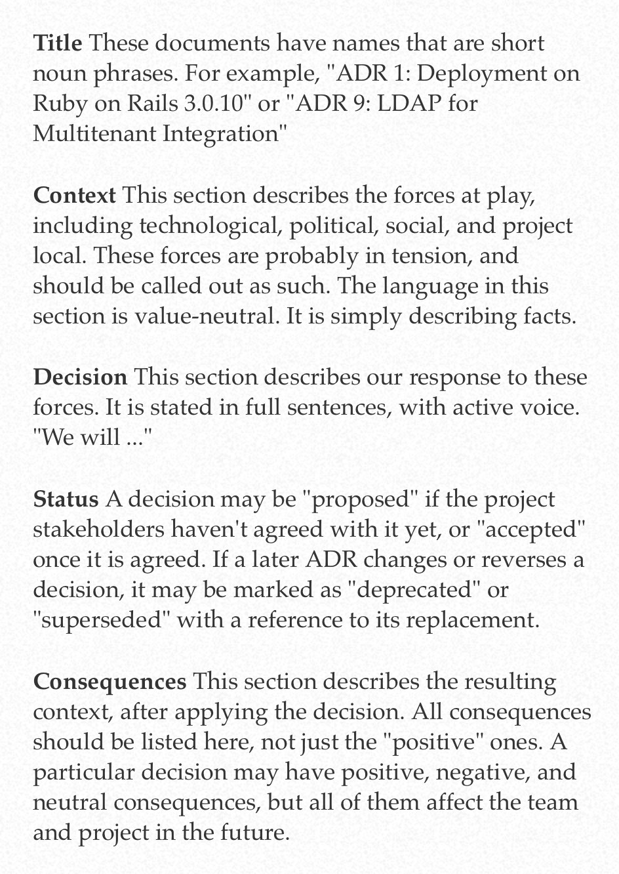
“Architecture Decision Record”
A short description of an architecturally significant decision
https://cognitect.com/blog/2011/11/15/documenting-architecture-decisions

